Slide 1



Cloud Development with AWS and Docker Compose
Johnathan Phillips
October 2024
Notes:
Hello, everyone! My name is Johnathan Phillips. I’m Computer Science major at Southern New Hampshire University. Today, I'll be presenting my recent work on building a cloud-hosted website using AWS and Docker Compose. We’ll walk through the main concepts, from containerization to serverless cloud and security, to give you a clear picture of what goes into cloud development.

Slide 2

Introduction
Computer Science Major at Southern New Hampshire University
Interested in cybersecurity, cloud development, and artificial intelligence
Today, we'll be talking about using containers to launch a cloud hosted website!
Notes:
To start, a bit about me: I’m studying computer science with a focus on cloud development, cybersecurity, and artificial intelligence. In this project, I launched a containerized, cloud-hosted application. We’ll go over the some of the setup and benefits of using containers and serverless technologies for this purpose.

Slide 3

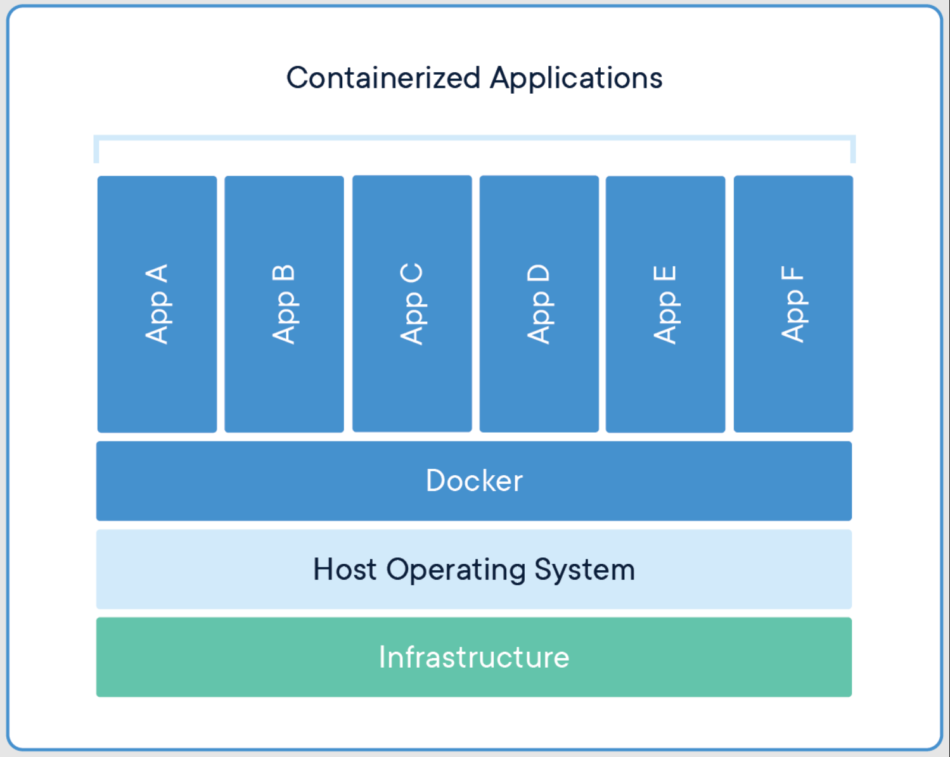
Containerization
What is Containerization?
Containerization packages an application and its dependencies, enabling consistent performance across environments.
Migration Models Used
Frontend and Backend Containers: Separate containers for frontend and backend services for isolation and portability.
Microservices Model: Enables independent development, deployment, and scaling of each service.
Orchestration with Docker Compose: A single YAML file sets up containers and networks, ensuring smooth communication
Notes:
Containerization is a method of packaging an application with its dependencies, ensuring consistent behavior across environments. To migrate our full stack application to the cloud, I used a few key models.
First, I separated the frontend and backend into their own containers, creating isolated and portable environments. This setup aligns with a microservices model, which allows each service to be developed, deployed, and scaled independently.
Finally, Docker Compose was used to orchestrate these containers. By configuring everything in a single YAML file, Docker Compose enables seamless communication between services, making deployment to the cloud efficient and scalable – more on YAML files in the next two slides.

Slide 4
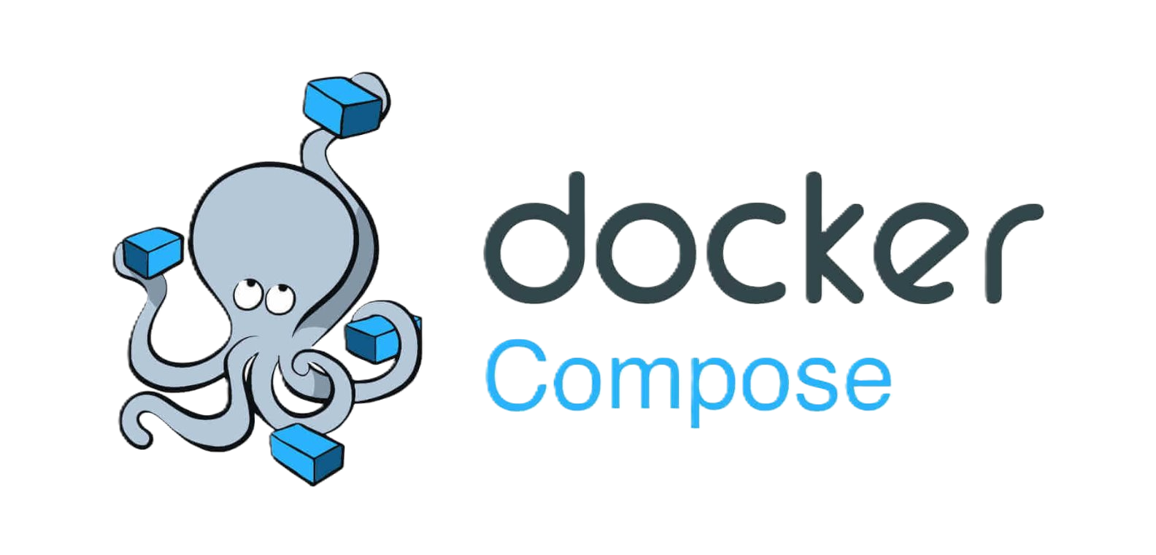
Orchestration
Each container operates independently, isolating applications and reducing conflicts.
Containers are lightweight, using fewer resources than traditional virtual machines.
Simplified control with YAML files – one file configures both containers and network settings, enabling easy setup.
Communication between frontend and backend services can be established with a closed, internal network for seamless data flow.
Instructions Sent
docker-compose.yaml
Build
Docker Compose​
Application Image​
Run
Application Container
Notes:
Once we have containers, the next step is orchestration. Each container operates independently, which prevents conflicts and keeps resources isolated. Docker Compose simplifies orchestration by using a YAML file to manage multiple containers and their network settings. This setup allowed me to link the frontend and backend with a closed, internal network, ensuring smooth data flow between services.

Slide 5

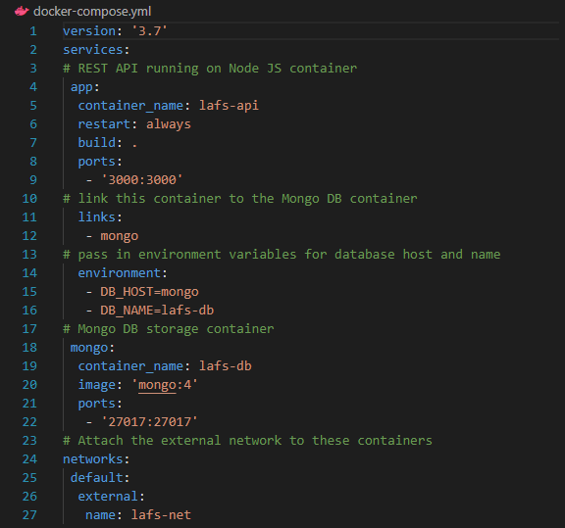
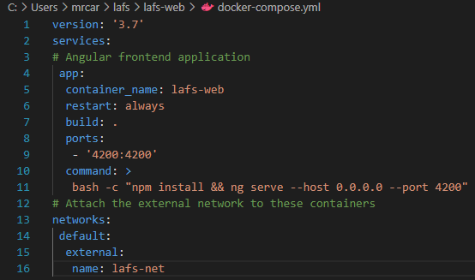
YAML Example Files
docker-compose up
Notes:
Here’s a couple of the Docker Compose YAML files used in this project. A single configuration file specifies both the application containers and network requirements, making deployment much easier. By defining services and ports in a YAML file, I can launch and manage the entire application environment with one command, docker-compose up.

Slide 6


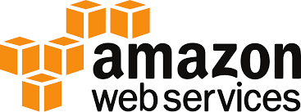

The Serverless Cloud Serverless Architecture
Definition: Serverless is a cloud computing model where the cloud provider automatically manages the infrastructure, so developers can focus solely on code.
Advantages:
No Server Management: No need to handle server provisioning, maintenance, or scaling.
Scalability: Serverless architectures scale automatically with demand, ensuring applications remain responsive.
Cost Efficiency: Pay only for the actual execution time of functions, rather than for idle server time.
Notes:
Moving on to the serverless cloud. Serverless is a cloud computing model where the provider, in this case, AWS, manages the infrastructure. This allows developers like us to focus on code rather than server setup or maintenance. Serverless solutions are scalable, adjusting automatically with demand, and cost-efficient, as you pay only for the time your code runs rather than for idle server capacity.

Slide 7
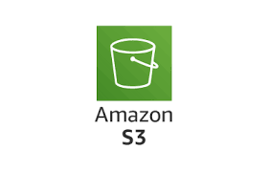
The Serverless Cloud What is S3 Storage?
Definition: S3 (Simple Storage Service) is an AWS service that provides scalable, secure storage in the cloud.
Comparison to Local Storage:
Availability: S3 storage is accessible over the internet, unlike traditional local storage.
Scalability: Offers unlimited storage capacity, expanding as needed without user intervention.
Notes:
An essential part of this project was S3 storage. S3, or Simple Storage Service, is AWS’s scalable cloud storage solution. Unlike local storage, S3 is accessible over the internet and can expand automatically to meet storage needs. It’s secure and provides an ideal place for storing application files, databases, and backups that can be accessed globally.

Slide 8
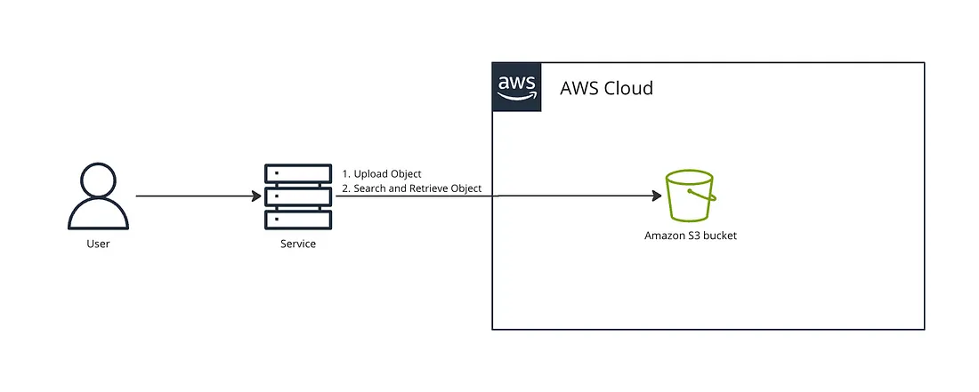
The Serverless Cloud What is S3 Storage?
Notes:
This slide shows a very simplified version of how S3 storage works within the AWS cloud. AWS S3, or Simple Storage Service, allows users to store and retrieve data over the internet. Here, you see how a user can interact with a service that uploads objects to an S3 bucket. Once stored in the S3 bucket, these objects can be searched and retrieved whenever needed.
This approach provides two main advantages. First, availability—data stored in S3 is accessible from anywhere with internet access, making it ideal for applications with a global audience. Second, scalability—S3 expands automatically to meet data storage demands, so it grows alongside your application without requiring manual intervention. This flexibility makes S3 an essential tool for cloud-hosted applications.

Slide 9
The Serverless Cloud API & Lambda
Advantages of Serverless API:
No Infrastructure Management: APIs operate without dedicated servers, managed entirely by AWS.
On-Demand Scaling: Serverless APIs scale automatically with usage, ensuring efficient resource allocation
Cost Savings: Only pay for actual API calls, avoiding idle server costs.
API calls used in question/answers database project:
GET
POST
DELETE
PUT
Used on endpoints like /Questions and /Answers
Notes:
AWS also offers serverless APIs through API Gateway, which we combined with Lambda functions. Serverless APIs handle requests without dedicated servers, scaling automatically with traffic. This is cost-efficient because it charges based on actual usage.
Specifically, this project uses several API calls like GET, POST, DELETE, and PUT to interact with a questions and answers database. These calls are handled by endpoints like /Questions and /Answers, enabling efficient backend operations.

Slide 10
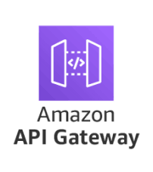
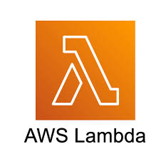
The Serverless Cloud API & Lambda
How Lambda Functions Work:
Lambda Basics: AWS Lambda runs code in response to events (e.g., HTTP requests from API Gateway) and scales based on demand.
Lambda API Logic: In this project, Lambda functions handle backend logic, like responding to user inputs and querying databases.
Key Scripts and Integration Steps:
Script Examples: Created functions like EchoFunction and TableScan for simple interactions and database queries.
Frontend and Backend Integration: Connected Lambda to API Gateway, enabling the frontend to trigger backend actions seamlessly.
Notes:
Let’s go deeper into Lambda functions. Lambda is AWS’s event-driven compute service, which runs code in response to specific events—such as HTTP requests from the API Gateway. In this project, Lambda functions handle backend logic, responding to user inputs and querying databases. For instance, I created functions like EchoFunction and TableScan to manage interactions and data retrieval.
The integration connects Lambda functions to the API Gateway, allowing the frontend to seamlessly trigger these backend actions without needing dedicated servers.

Slide 11
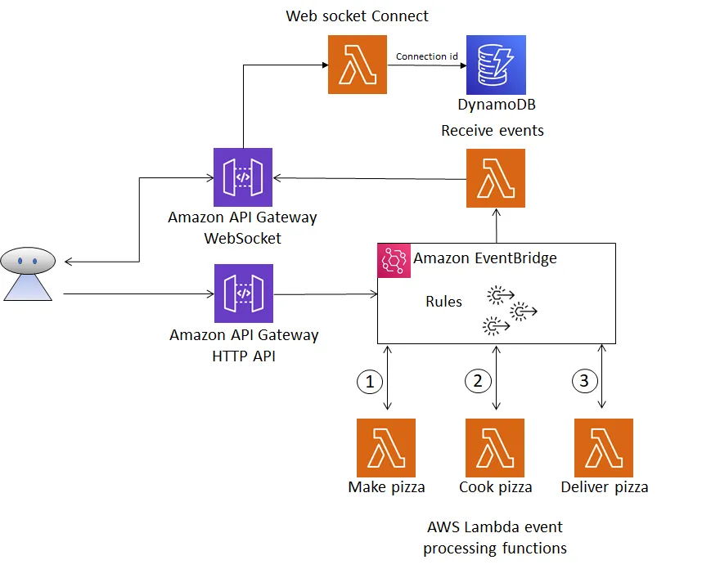
The Serverless Cloud API & Lambda
In the project code to update, get, delete, or post questions/answers, the Lambda functions are actually called:
GetSingleRecord
TableScan
UpsertAnswer
FindOneQuestion
UpsertQuestion
DeleteRecord
Notes:
Here are some of the key Lambda functions used in the project. Functions like GetSingleRecord, TableScan, and UpsertQuestion enable us to manage and interact with data in DynamoDB effectively. By implementing Lambda functions like DeleteRecord and FindOneQuestion, we gain full CRUD functionality to handle all user requests on the backend.

Slide 12
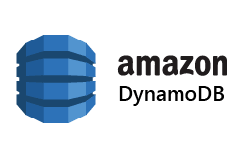
The Serverless Cloud Database
MongoDB vs. DynamoDB Data Models
MongoDB: A document-based NoSQL database that organizes data into collections of JSON-like documents, ideal for complex data structures and dynamic schema requirements.
DynamoDB: An AWS-managed NoSQL database that uses a key-value and document data model, optimized for high-performance queries and scalability within AWS environments.
Notes:
Now, let’s look at the database. In this project, I used DynamoDB, an AWS-managed NoSQL database that’s optimized for high-performance queries. Unlike MongoDB, which stores data in JSON-like documents, DynamoDB uses a key-value structure that works well for quick lookups and scalability.

Slide 13
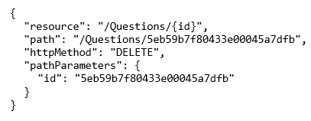
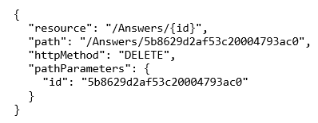
The Serverless Cloud Database
Sample JSON to delete a question in DynamoDB
Queries and Scripts in DynamoDB:
Queries Performed: Queried data using Lambda functions to fetch records by ID and scan for specific data points within tables.
Scripts Used:
Created Lambda functions (e.g., TableScan, GetSingleRecord) to retrieve filtered or unfiltered data from DynamoDB.
Used DynamoDB’s primary key structure to access specific data, improving response time and query efficiency.
…to delete an answer
Notes:
The primary queries we used were single record retrievals through GetSingleRecord and broader scans with TableScan, which allowed us to search for specific data points within tables. By using these queries in Lambda functions, we achieve high performance and efficient data access.
You can also see some example JSON queries on the right, specifically, one to delete a question and one to delete an answer in DynamoDB.

Slide 14
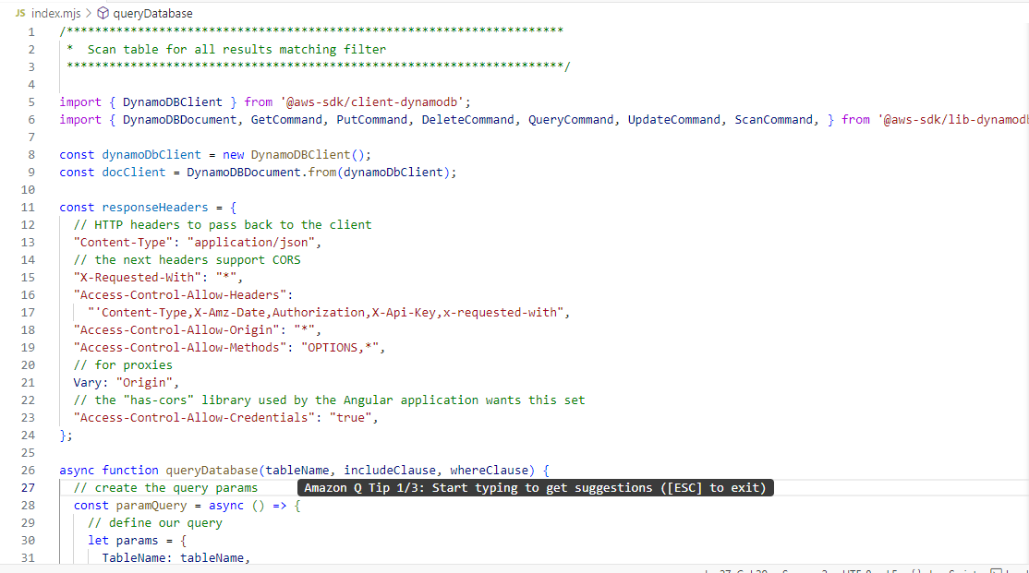
The Serverless Cloud Example Function Code Snippet for TableScan
Notes:
Here’s an example code snippet for the TableScan function. This Lambda function performs a scan across our DynamoDB table, retrieving records based on specified conditions. By leveraging DynamoDB’s primary key structure, TableScan efficiently filters results, improving the application’s response time and query efficiency.

Slide 15
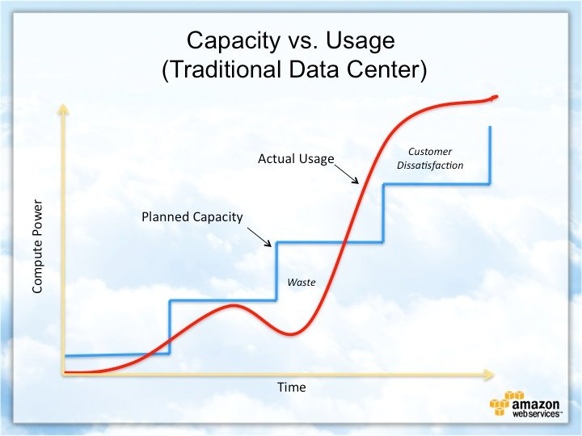
Cloud Based Development Principles
Elasticity in the Cloud:
Definition: Elasticity is the ability of cloud resources to automatically scale up or down based on demand.
Application in AWS: AWS dynamically allocates resources as needed, ensuring applications remain responsive during high traffic and cost-efficient during low demand.
Pay-for-Use Model:
Definition: Pay-for-use means you’re billed only for the actual amount of resources used.
AWS Example: In this project, services like Lambda and S3 follow this model, charging only for execution time and storage used, rather than for reserved capacity.
Notes:
Cloud development has two key principles: elasticity and the pay-for-use model. Elasticity means resources can scale up or down automatically based on demand, ensuring applications remain responsive while also being cost-effective during low-usage periods.
In the pay-for-use model, AWS only charges for the resources actually consumed. For example, Lambda charges based on the time a function runs, and S3 costs are based on the actual data stored. This aligns costs with usage, which is highly efficient.

Slide 16
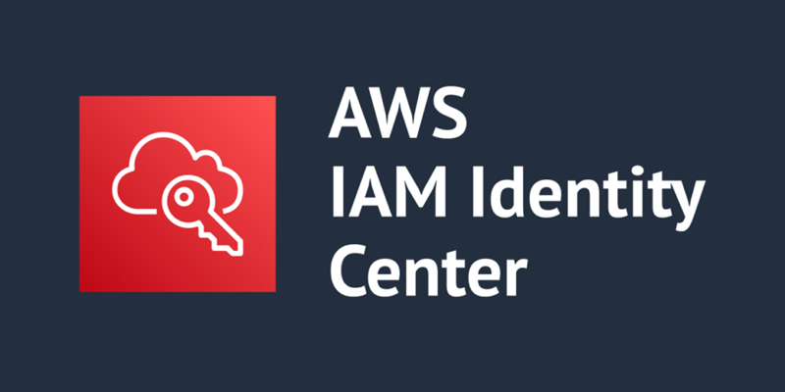

Securing Your Cloud Application
Preventing Unauthorized Access:
Access Controls: Implemented identity and access management (IAM) roles and policies to define who can access specific resources.
Role-Based Access: Used roles to assign permissions, ensuring only authorized users and functions can access sensitive parts of the application.
Roles and Policies in AWS:
Roles and Policies Relationship: Policies define what actions are allowed, while roles are assigned to users or services to enforce these policies.
Custom Policies Created: Developed custom policies to limit access to specific S3 buckets, Lambda functions, and DynamoDB tables.
Securing Connections (Lambda and API Gateway):
Connection Security: Secured interactions between API Gateway and Lambda with IAM (Identity and Access Management) permissions, restricting access based on user roles.
Database and S3 Security: Limited access to DynamoDB and S3 by setting permissions that control who can read, write, or delete data.
Notes:
Security is critical in cloud applications, and AWS provides several tools to control access to resources. For this project, I implemented access controls using IAM roles and policies. IAM roles determine who can access which resources, while policies define what actions are permitted.
Custom policies were created to restrict access to specific resources like S3, Lambda functions, and DynamoDB tables. Additionally, I secured connections between API Gateway and Lambda by configuring IAM permissions to control which users and services have access. This layered approach protects sensitive data and ensures secure interactions between components.

Slide 17

Conclusion
Key Takeaways:
Cloud Migration Process: From containerization to serverless APIs, the project demonstrates a complete migration from a full-stack application to a cloud-native architecture on AWS.
Benefits of Serverless: Using AWS services like Lambda, API Gateway, and S3 allows for scalable, cost-effective, and responsive applications.
Security and Efficiency: With IAM roles and policies, AWS ensures secure access control, and the pay-for-use model provides efficient resource utilization.
Notes:
So, in conclusion, this project covered concepts from cloud migration, to containerization, serverless APIs and database management. We saw how serverless solutions enable scalability and cost savings, while AWS IAM roles and policies help secure our application.
Thank you for your time, and I hope this presentation has highlighted the benefits of serverless cloud solutions and the potential AWS offers for modern web applications.

Slide 18
Citations
Docker Containerization Diagram
Docker. (2024). Use Containers to Build, Share and Run Your Applications. Docker. https://www.docker.com/resources/what-container/
API & Lambda Diagram
Pandya, R. (December 4, 2024). Event Driven Architecture with Amazon API Gateway, Amazon EventBridge and AWS Lambda. Medium. https://medium.com/@rplearn06/event-driven-architecture-with-amazon-api-gateway-amazon-eventbridge-and-aws-lambda-7b51d9f41841
S3 Bucket Use Diagram
Alles, P., (March 7, 2024). Expand AWS S3 Content Search capability from File name search to Advanced Query Search. Medium. https://medium.com/@paulallles/expand-aws-s3-content-search-capability-from-file-name-search-to-advanced-query-search-0dfd99903565
Capacity vs. Usage Diagram – AWS
Sourced by Southern New Hampshire University
All icons, logos, and other intellectual property (IP) belong to their respective owners. I do not claim any ownership of the IP referenced in this slideshow.

